Slide 1

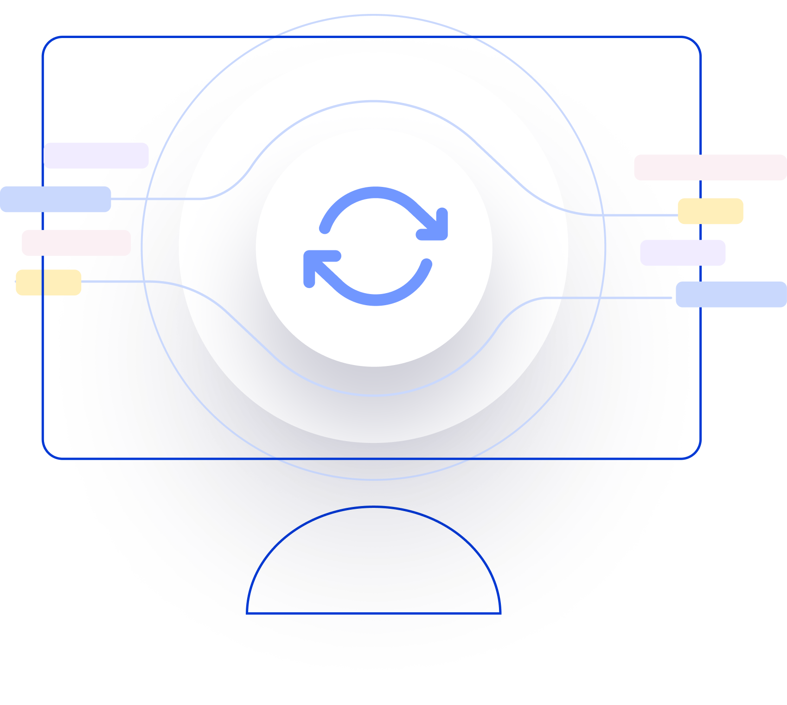
Next Generation AI for Document Automation – Accounts Payables
Weekly Report CW
#placeholder
January 2024

Slide 2


Slide 3
Agenda
RAID (Risks, Actions, Issues & Decisions) Follow-up
Project Status & Timeline Review
Highlight Topics

Slide 4
Risks – Focus on Open / In Response
RAID (Risks, Actions, Issues & Decisions) Follow-up
Status | Open at | Id | Description | Priority | Action Id | Action Description | Action Responsible | Action Status
Open | 2024-11-08 | R001 | Data Acquisition dependent on SAP addon release and installation - could break project timeline | High | A001 | EON SAP DEV Team onboarding for integration implementation. EON PM to raise resource request to the respective team and actively following up. |  | Open
Open | 2024-11-08 | R002 | Workflow integration might take more resources than expected | High | A002 | Discuss Solution Design extensively and support if needed |  | Open
 |  |  |  | High | A003 | Hypatos x EON to revisit Integration and Project Timelines based on resource onboarding. Dependent on A001. Bi-Weekly follow ups. |  | Open
 |  |  |  | High | A004 | Allow a buffer for SIT |  | Open
Open | 2024-11-08 | R003 | PO Matching config and ML Training takes more resources than expected | High | A005 | Schedule a session with HY SAP and Product Team to |  | Open
Open | 2024-11-08 | R004 | Scope of Implementation not clear - customer expectations are not aligned with HY | High | A006 | Create and Sign SoW |  | Open
Open | 2024-11-08 | R005 | Project Closing Date not able to achieve due to vacation of important stakeholders | Medium | A007 | Create Absence Planning and Backups for PMs and Key Stakeholders |  | Open
Open | 2024-11-08 | R006 | Tax Compliance config and ML Training takes more resources than expected | High | A008 | Schedule a session with PWC and EON Tax team for further alignment |  | Open
* Update since last week Live Update

Slide 5
Issues
RAID (Risks, Actions, Issues & Decisions) Follow-up
Status | Opened at | Closed at | Id | Description | Priority | Risk Id | Risk Description | Action Id | Action Description | Action Status
* Update since last week Live Update

Slide 6
Decisions
RAID (Risks, Actions, Issues & Decisions) Follow-up
Id | Decision Detail | Decision Impact | Decision Date | Proposed by | Approved by | Alternatives Considered
D001​
D002​
D003​
D004​
* Update since last week Live Update

Slide 7
Agenda
RAID (Risks, Actions, Issues & Decisions) Follow-up
Project Status & Timeline Review
Highlight Topics

Slide 8


Weekly Report –
Projects Status & Timeline Review
#CWPlaceHolder
-
G
Achievements
Next Steps
…
…

Slide 9
Indicative Project Plan for E.ON MVP Go-Live in Mar ’25 + Roll-out and Enhancement Waves along 2025
Focus
E.ON new milestone needed: VIM redesign
Implementation Approach
Oct
Nov
Dec
Jan
Feb
Mar
Apr
May
Responsible
Owner
Activities
CW
43
44
45
46
47
48
49
50
51
52
01
02
03
04
05
06
07
08
09
10
11
12
13
14
15
16
17
18
19
Conceptualization & Planning
Project Initiation, Planning & Reviews
Hy PM, E.ON PM
Hy
Current State Assessments
Hy SA, E.ON FT
Hy
Functional Solution Design
Solution Design updated based on testing outputs
Hy SA. E.ON FT
Hy
Technical Solution Design
Hy SA, E.ON IT
Hy
AI Training
Training Data Acquisition
Hy COE
Hy
AI Agent optimization
AI Agent v1
AI Agent v2
Hy COE & QA
Hy
Implementation Sprints
Application implementation
Hy COE & QA
Hy
Hy Studio & Insights v1
Hy Studio & Insights v2
Integration implementation
Add-on installation Data exports
Hy COE, E.ON IT
E.ON
System Integration Testing
SIT Sign-off
E.ON IT
E.ON
Initial Go-live (MVP)
UAT (User Acceptance Test)
UAT Sign-off
Hy QA, E.ON FT
E.ON
User training
Test Plan
User readiness for E.ON Solution
Hy PM, E.ON FT
E.ON
Prod Cutover
Hy Foundation
Hy COE, E.ON IT
Hy
Hypercare support & Data Gathering
Cut-over Plan
Hy IM
Hy
Roll-outs
Dependency for subsequent work items and go-live date
Hypercare
Data Gathering
Wave 2
Roll-out Plan
Hy PM
Hy
E.ON Year end closing
SteerCo Meeting
Full time / Mandatory
Kick-off
& Workshops
Hy SAP connector & training data readiness
Design Sign-off
UAT Ready
Go-live Date
decision
Go-live date
Hypercare end
Roll-out Go/NO Go
Key to reference:
COE = Center Of Excellence E.ON = E.ON FT = Functional Team
Hy = Hypatos
PM = Project Manager
QA = Quality Assurance SA = Solution Architect
Project Milestone
Partial time / Optional
E.ON Deliverable
Hypatos Deliverable
Limited Availability
~ 6 months Pilot phase period (4 months of implementation + 2 productive testing period)

Slide 10








Focus
Technical Infrastructure Overview
OpenText Integration blueprint for E.ON via SAP Add-on
Hypatos SAP Connector periodically collects master, PO and posting data (including archive images for initial model training) required for master data enrichment and attribute prediction in Hypatos Studio
Retrieved data is sent to Hypatos cloud via Hypatos REST API
Emailed and scanned invoices are inserted into Hypatos Studio for processing
Hypatos Studio extracts, enriches and completes the documents
Hypatos SAP Connector regularly calls Hypatos REST API to fetch document data and invoice image from Hypatos Studio
Hypatos SAP Connector calls SAP BADI implementation passing in and mapping document data
BADI implementation calls VIM function module for creation and archiving of invoice
1
Archive
Master Data
Posting Data
7
Invoices
Function Module: Create invoice
Emailed invoices
Paper based invoices (scanned)
2
6
Hypatos SAP Connector³
1
3
BADI implementation
Email Inbox
2
4
5
Document data and document image
5
3
Hypatos REST API²
6
Email Service¹
4
Extract
Enrich
7
Complete
Validate
¹ https://docs.hypatos.ai/user-guide/document-upload/email-service
² https://hypatos.redoc.ly/#section/Introduction
³ https://docs.hypatos.ai/integrations/sap-integration
Hypatos cloud
E.ON premise

Slide 11
Agenda
RAID (Risks, Actions, Issues & Decisions) Follow-up
Project Status & Timeline Review
Highlight Topics

Slide 12



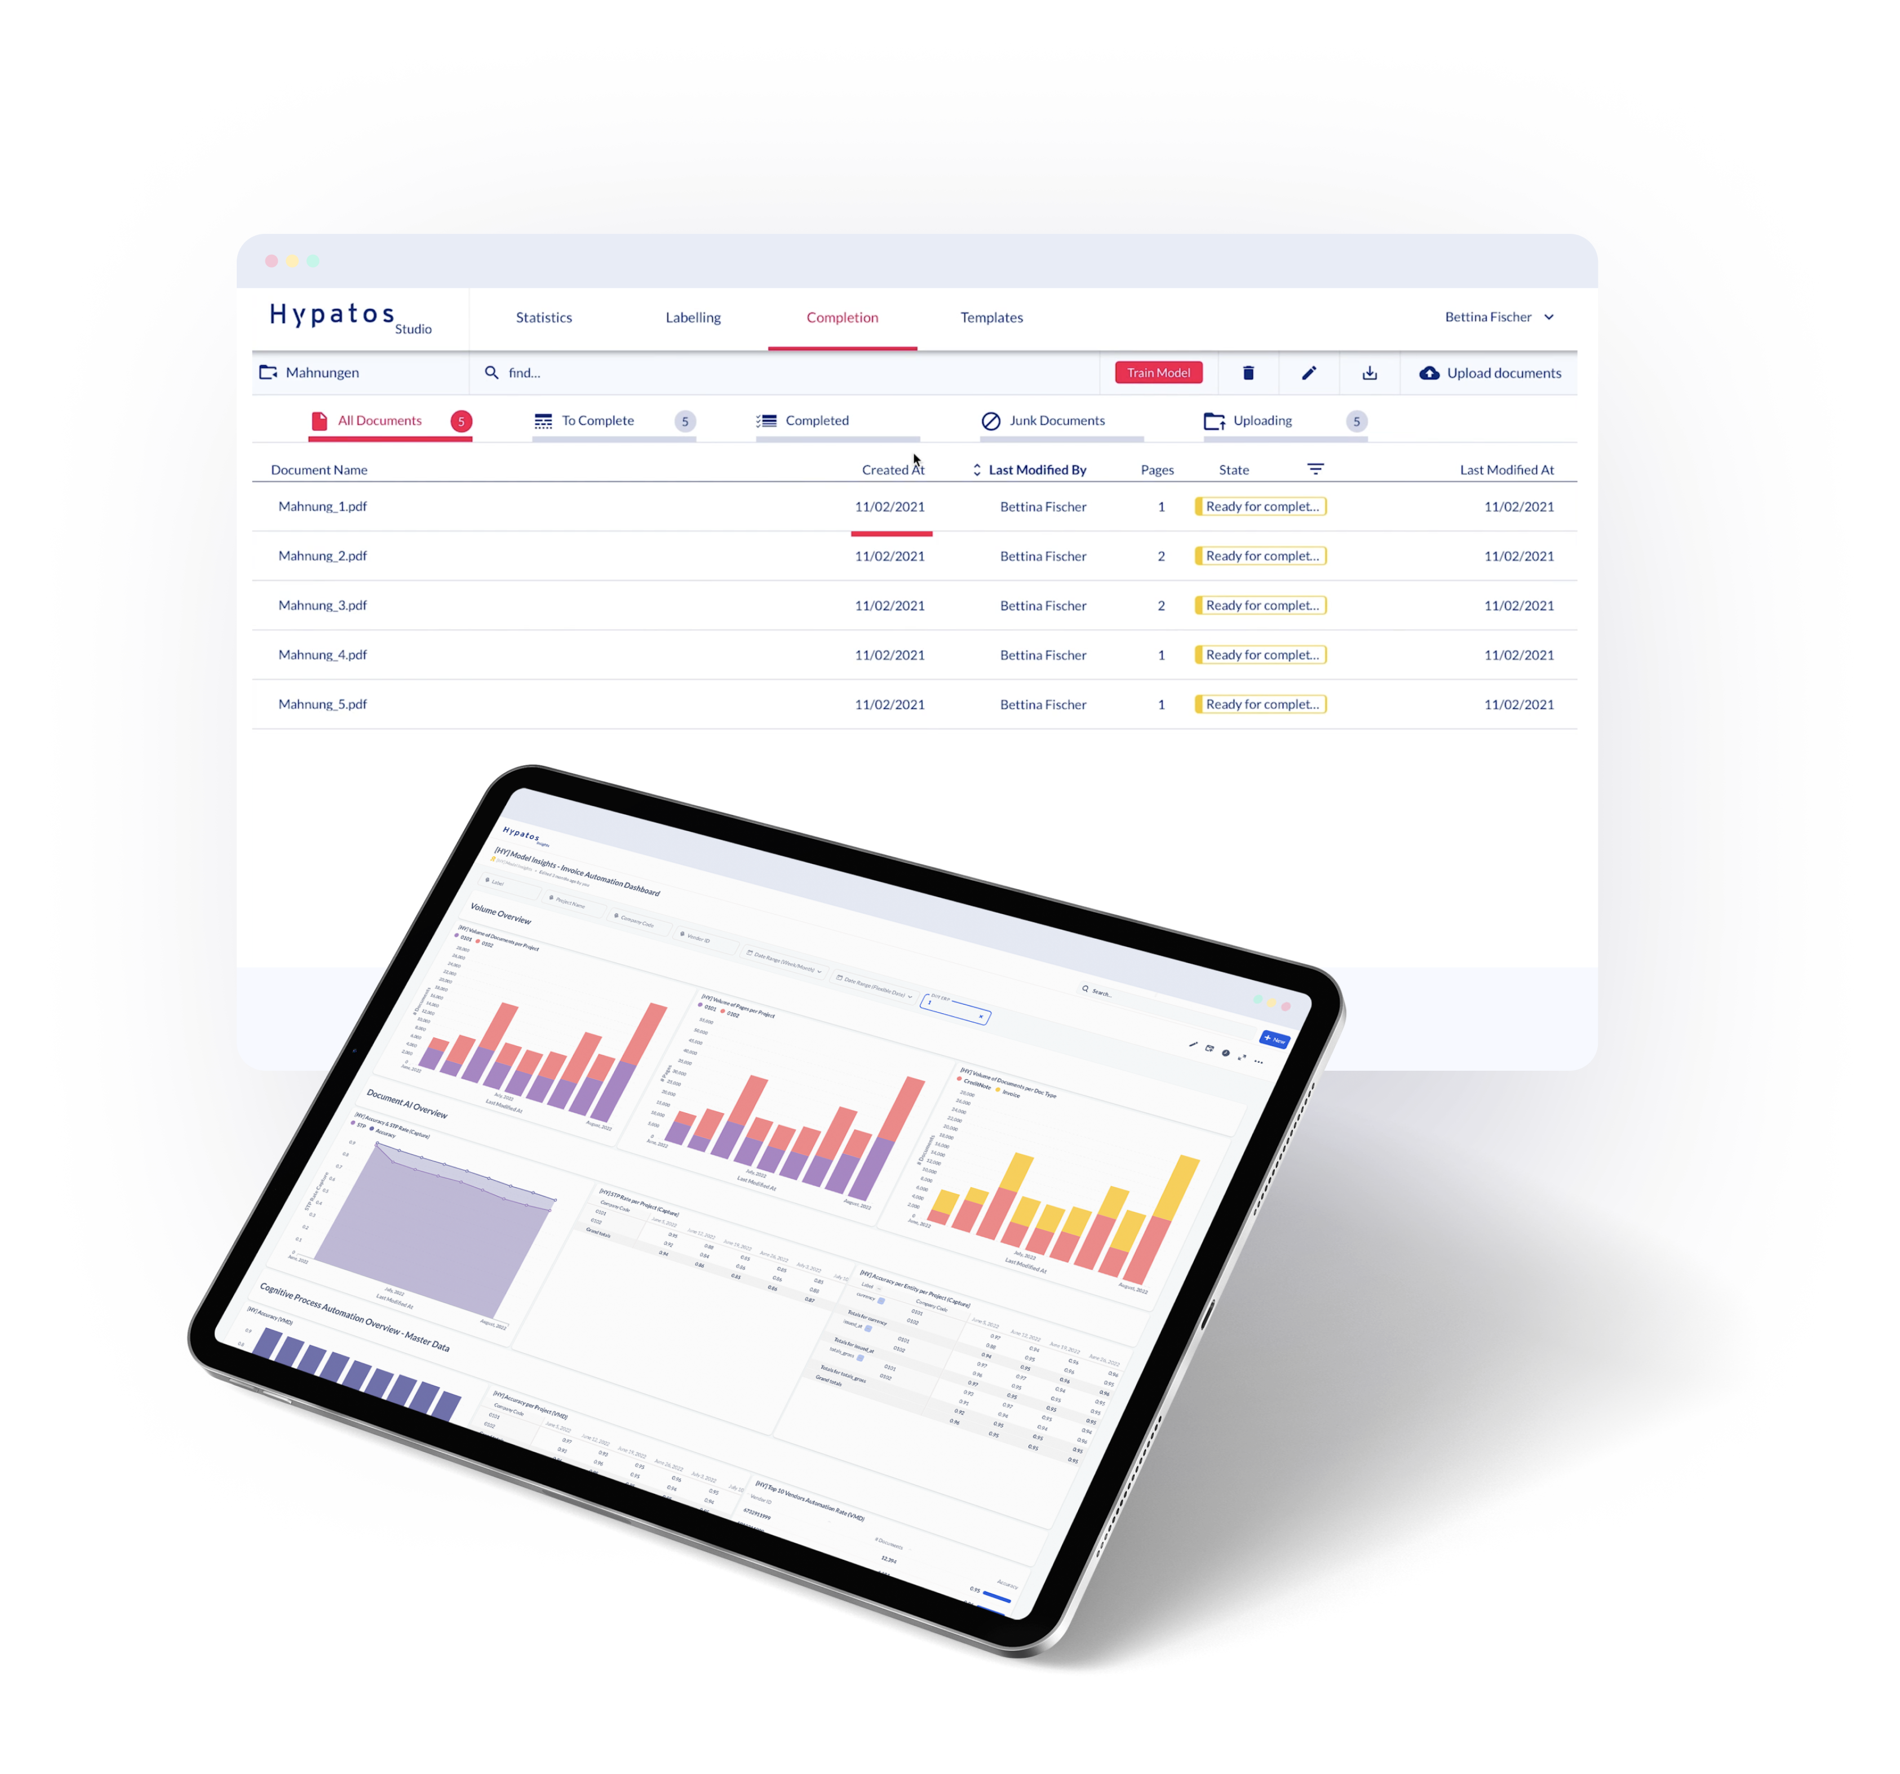
Thank you
Jorge Costa
PS Director
jorge.costa@hypatos.ai
hypatos.ai
Ekaterina Mironova
Solution Architect
ekaterina.mironova@hypatos.ai
hypatos.ai
Yavuz Guney
Project Manager
yavuz.guney@hypatos.ai
hypatos.ai

